Slide 1

OBJECT ORIENTED MODELLING & DESIGN (OOMD)
SOFTWARE TESTING
UE18CS400SB
Prof. Venkatesh Prasad
venkateshprasad@pes.edu
Department of Computer Science

Slide 2
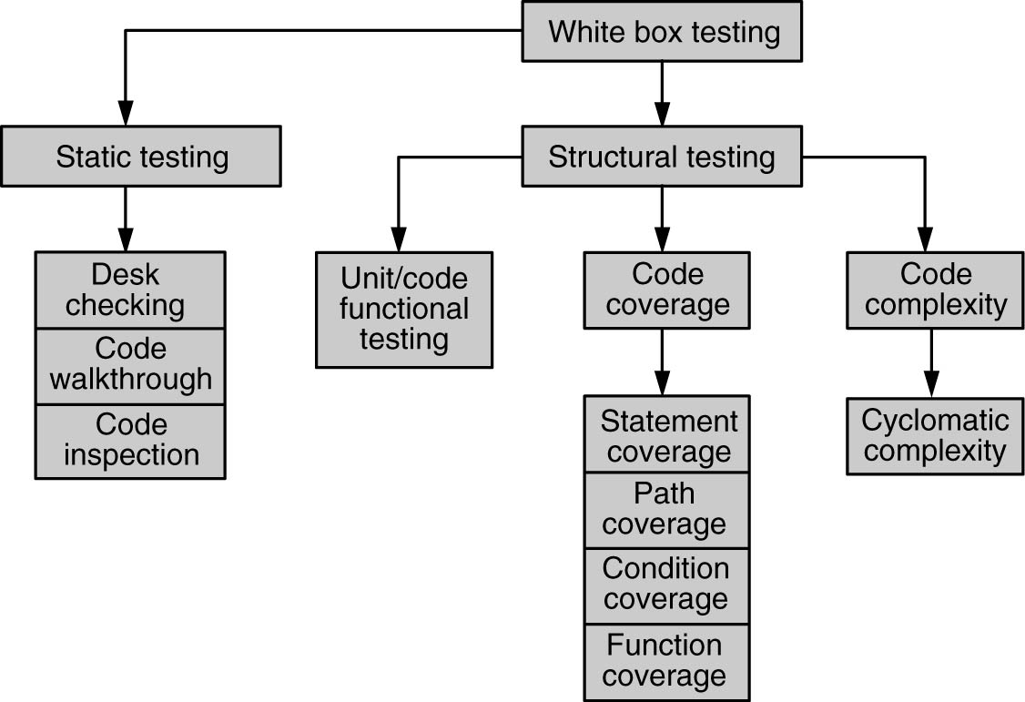
Types of White Box Testing

Slide 3
Code Walk through
Group oriented (as against desk checking)
Brings in multiple perspectives
Multiple specific roles (author, moderator, inspector, etc.), as discussed in Fagan Inspection
Simpler Variant
Another peer/Senior person goes through the code alone after an initial brief and occasional clarifications
More common and efficient too.

Slide 4
Code Inspection
Group-oriented activity
Highly formal and structured
Multiple participants with specific roles
Requires thorough preparation
Documentation of diverse views
Review in a defined structured manner.

Slide 5
Roles of Formal Inspection
Author
Author of the work product
Makes available the required material to the reviewers
Fixes defects that are reported
Moderator
Controls the meeting(s)
Inspectors (reviewers)
Prepare by reading the required documents
Take part in the meeting(s) and report defects
Scribe
Takes down notes during the meeting
Assigned in advance by turns
Can participate to review to the extent possible
Documents the minutes and circulates them to participants

Slide 6
Process in a Fagan Inspection
Typical documents circulated:
Program code
Design / program specifications
SRS (if needed)
Any applicable standards (e.g., coding standards)
Any necessary checklists (e.g., code review checklist)
Notes:
A Fagan inspection is a process of trying to find defects in documents during various phases of the software development process. It is named after Michael Fagan, who is credited as being the inventor of formal software inspections

Slide 7
Process in a Fagan Inspection
Preliminary meeting (optional)
Author explains his / her perspective
Makes available the necessary documents
Highlights concern areas, if any, for which review comments are sought
Defect Logging Meeting
All come prepared!
Moderator goes through the code sequentially
Each reviewer comes up with comments
Comments / defects categorized as “defect” / “observation,” “major” / “minor,” “systemic” / “mis-execution”
Scribe documents all the findings and circulates them
Follow-up meeting (optional)
After Author fixes defects
If required, a follow-up meeting is called to verify completeness of fixes

Slide 8
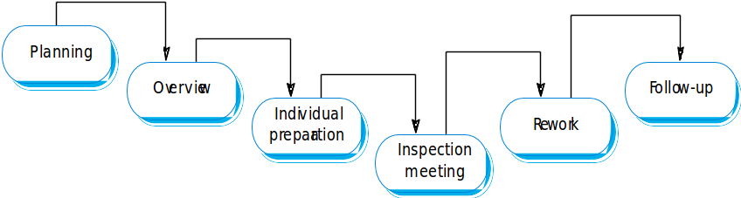
Inspection Process

Slide 9
Advantages & Didavantages of Fagan Inspection
Advantages
Thorough, when prepared well
Brings in multiple perspectives
Has been found to be very effective
Disadvantages
Logistically difficult
Time consuming
May not be possible to exhaustively go through the entire code

Slide 10
Tools usage for static analysis
Whether there are unreachable codes
Variables declared but not used
Mismatch in definition and assignment of values to variables
Illegal or error-prone type-casting of variables
Use of non-portable or architecture-dependent programming constructs
Memory allocated but not having corresponding statements for freeing up memory
For calculation of cyclomatic complexity
As an extension of compilers (lint, compiler flag driven checking…)
Coding standards adherence
Variable naming, indentation, in-line documentation……
Best practice violations – Hard codings…
https://www.softwaretestinghelp.com/tools/top-40-static-code-analysis-tools/

Slide 11
Uses of Cyclomatic Complexity
Helps developers and testers to determine independent path executions
Developers can assure that all the paths have been tested at least once
Helps us to focus more on the uncovered paths
Improve code coverage in Software Engineering
Evaluate the risk associated with the application or program
Using these metrics early in the cycle reduces more risk to the program
https://www.guru99.com/cyclomatic-complexity.html
Notes:
Cyclomatic complexity is a software metric used to indicate the complexity of a program.
It is a quantitative measure of the number of linearly independent paths through a
program's source code. It was developed by Thomas J. McCabe, Sr. in 1976.
Independent path is defined as a path that has at least one edge which has not been traversed before in any other paths.

Slide 12
Static Analysis Tool - LINT
#include <stdio.h>
printarray (Anarray)
int Anarray;
{ printf(“%d”,Anarray); }
main ()
{
int Anarray[5]; int i; char c;
printarray (Anarray, i, c);
printarray (Anarray) ;
}
----------------------- Tool execution
lint lint_ex.c
------------------------ Output
lint_ex.c(10): warning: c may be used before set
lint_ex.c(10): warning: i may be used before set
printarray: variable # of args. lint_ex.c(4) :: lint_ex.c(10)
printarray, arg. 1 used inconsistently lint_ex.c(4) :: lint_ex.c(10)
printarray, arg. 1 used inconsistently lint_ex.c(4) :: lint_ex.c(11)
printf returns value which is always ignored

Slide 13
Structural Testing
Done by running the executable on the machine
Entails running the product against some predefined test cases and comparing the results against the expected results
Designing test cases and test data ( even test programs – stubs )to exercise certain portions of code
Types of structural testing
Unit / code functional testing
Code coverage testing
Code complexity testing

Slide 14
Unit / Code Functional Testing
Initial quick checks by developer
Removes “obvious” errors
Done before more expensive checks
Building “debug versions”
Running through an IDE
“Debugging” or “testing”? (Who cares?!)
Done at programmer level
Most of the times – “indirect & controlled” execution because other parts of programs not ready
Stubs, test harnesses….
Unit testing tools – Junit…

Slide 15
Code Coverage Testing
Focus is to cover all / required parts of code
Map parts of code to required functionality
Find out percentage of code covered by “instrumentation”
Instrumented code provides fine control on execution and measuring it.
Can help identify critical portions of code, executed often
Coverage = ( statements executed / Total statements ) * 100

Slide 16
Code Coverage Testing
Focus is to cover all / required parts of code
Map parts of code to required functionality
Find out percentage of code covered by “instrumentation”
Instrumented code provides fine control on execution and measuring it.
Can help identify critical portions of code, executed often
Coverage = ( statements executed / Total statements ) * 100

Slide 17
Types of Code Coverage
Statement coverage
Path coverage
Condition coverage
Function coverage

Slide 18
Programming Construct
Sequential instructions
Two-way decision statements (if – then – else)
Multi-way decision statements (switch statements)
Loops, like while/do, for, repeat/until, etc

Slide 19
Programming Construct
Sequential instructions
Two-way decision statements (if – then – else)
Multi-way decision statements (switch statements)
Loops, like while/do, for, repeat/until, etc

Slide 20
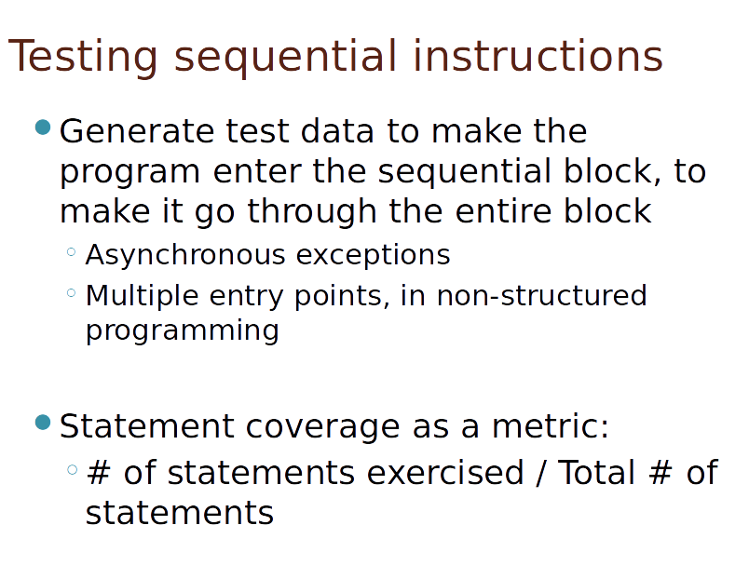

Slide 21
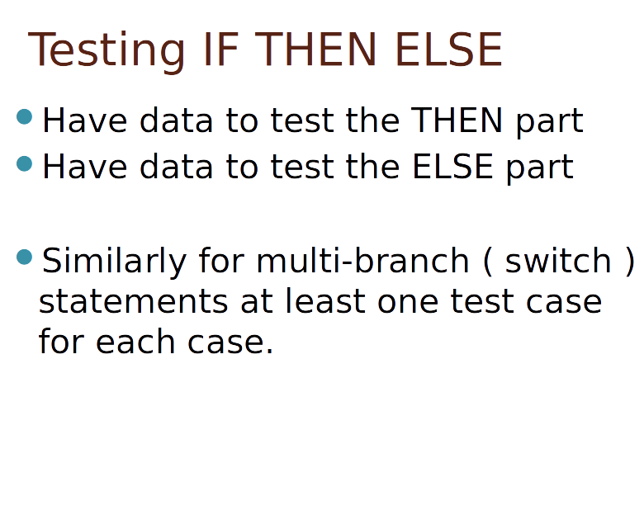

Slide 22
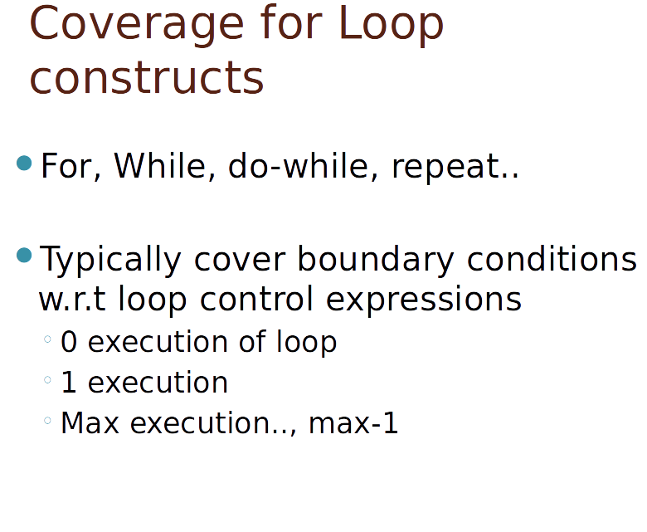

Slide 23
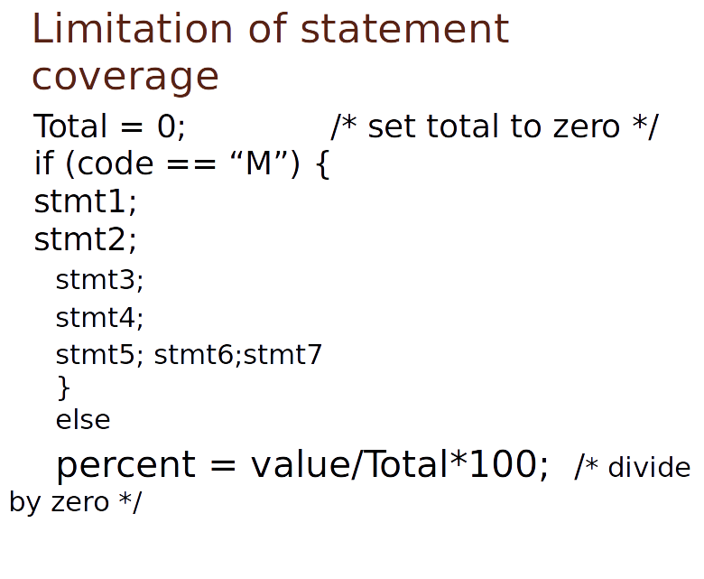

Slide 24
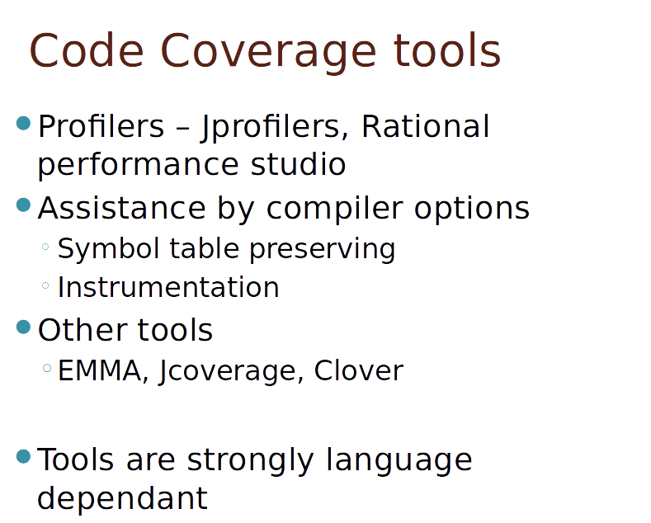

Slide 25
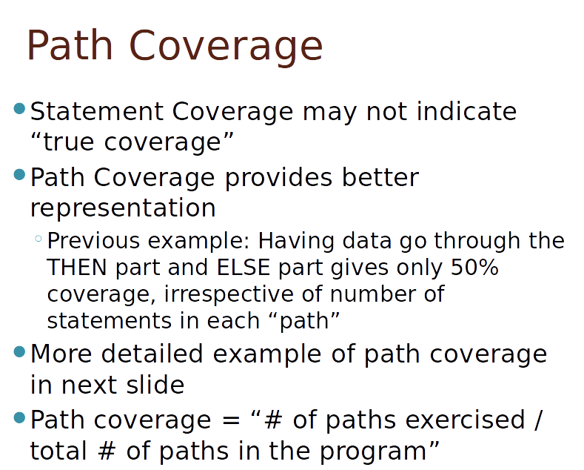

Slide 26
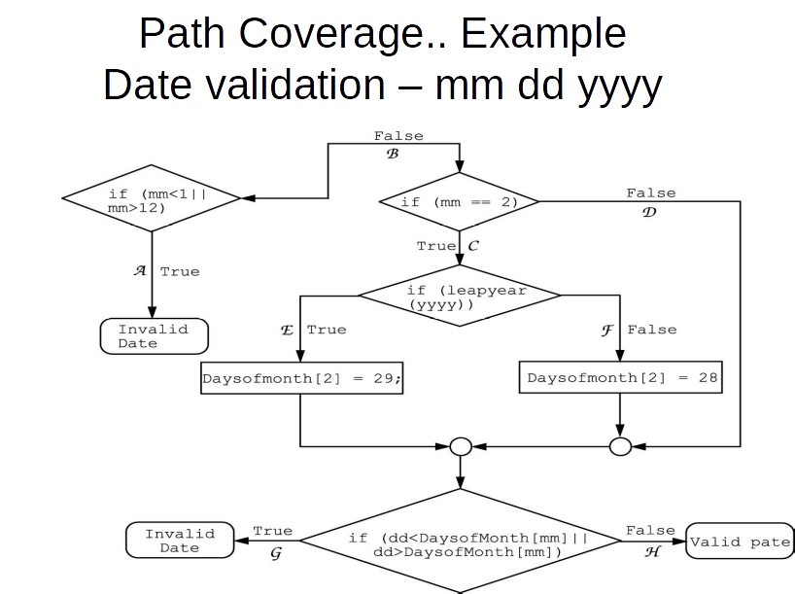

Slide 27
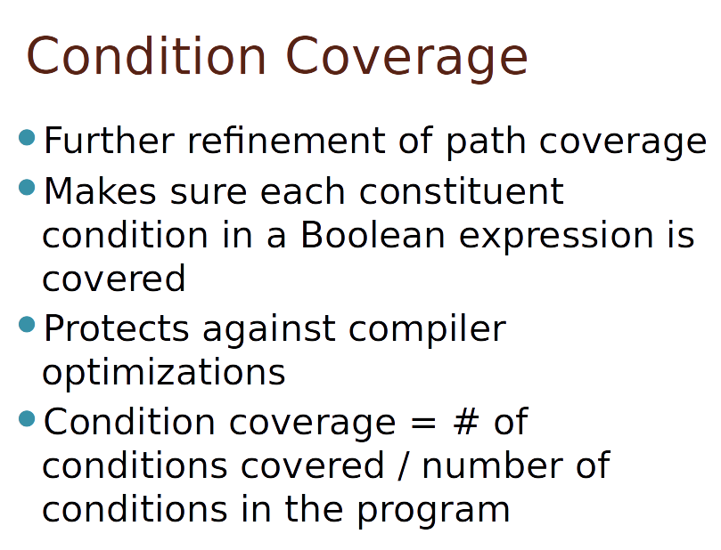

Slide 28
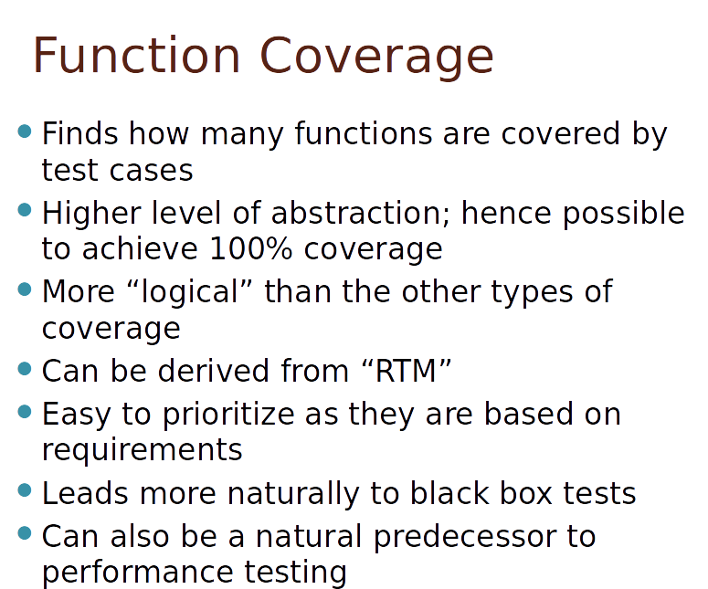

Slide 29
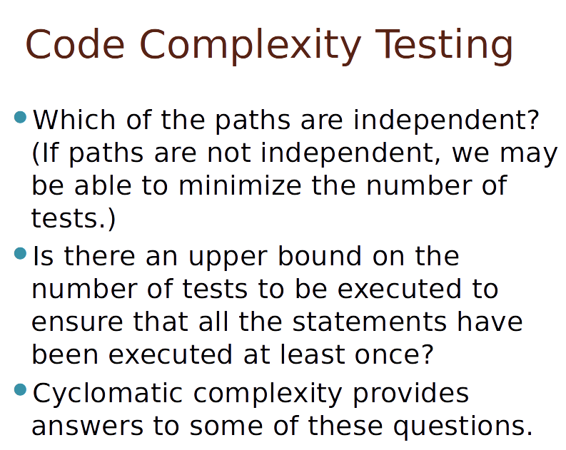

Slide 30
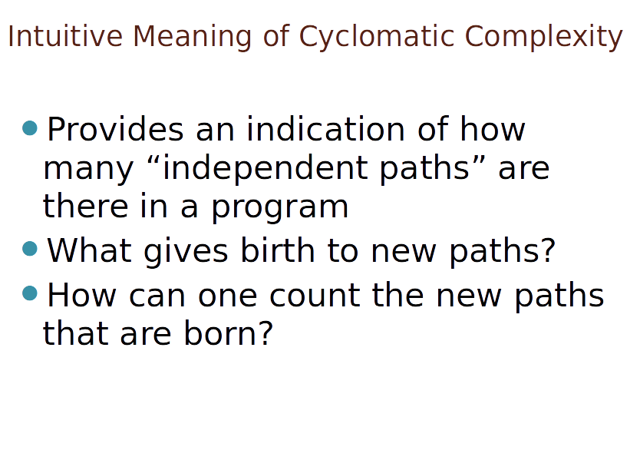

Slide 31
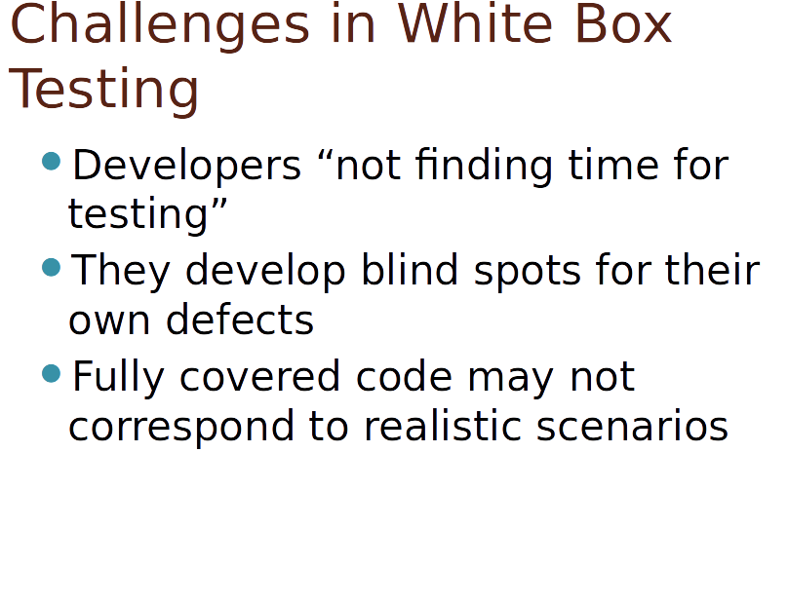

Slide 32
Limitation of White Box Testing
Tendency to miss the big picture
Implementation technology skill required
Progg. Language, database, environment, runtime behavior.
Deeper knowledge rquired
Including dev skills & IDE
Effort is significantly more
Additional development may be required
Source / documentation may not be available – fully / partly.

Slide 33
OBJECT ORIENTED MODELLING & DESIGN (OOMD)
THANK YOU
Prof. Venkatesh Prasad
venkateshprasad@pes.edu
Department of Computer Science

